Slide 1
MCG Research Training
Craig and Gib

Slide 2
Overview
Task
Identify “mega trends” that will affect Health Plans in the next 5 years
Team
Working underneath Industry-lead Partner with Senior Manager and Senior Consultant
Deliverable
Short deck to open discussions with two large health plans

Slide 3
Approach
Resources used:
Google: General research, Discover leads, Opinion pieces
Forrester: Articles on technology (especially good for trends)
Published Research: Scholarly research pieces from industry insiders
Subject Matter Experts: Guidance and hypotheses

Slide 4
Method
Document your research
    Build a data model to populate as you go
    Capture most relevant points for review later
    Save your sources as well as articles directly
    Be exhaustive
Make your research portable
    You won’t be the only user
      Project Lead
      Teammates
      Client
    It must be well organized
      Clear naming convention
      Index research
  Reference your research

Slide 5
Situation
Situation
Company A thinks that Company B has a significant price advantage in cereal production
We’re charged with testing this hypothesis and quantifying our findings
Complication
As a direct competitor, Company B will not help us with internal data
We had to devise an approach without their cooperation that still got the right answer
Approach
We decided to extensively interview employees at Company A and thoroughly understand math behind our cost position
Using external information and interviews, asses quantitative differences wherever possible

Slide 6
Cost bucket approach
Marketing
Used IRI data, expert interviews, former employees to determine approx. advantage
Raw Materials
Expert interviews of former employees through GLG
Used R&D to determine ingredients in cereal
Interviews of our employees and thorough relative benchmarking of our practices (what are the big differences here?)
Packaging
Used R&D/expert interviews again here
Manufacturing
Extensive Google/Factiva/Thomsen/etc. research to find articles citing production, employees, factory space
Interviews around practices that could drive cost differences
Supplemented with cold calls and analyst calls

Slide 7
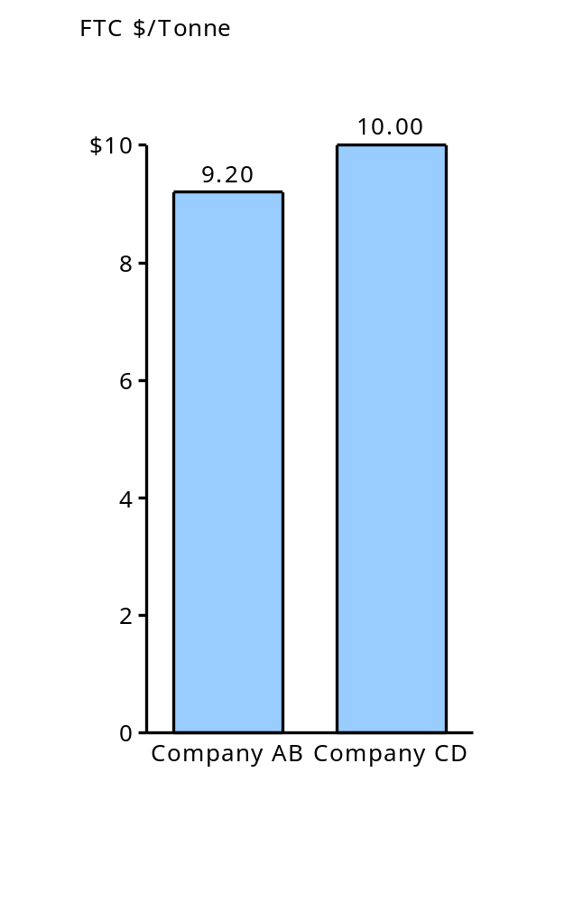
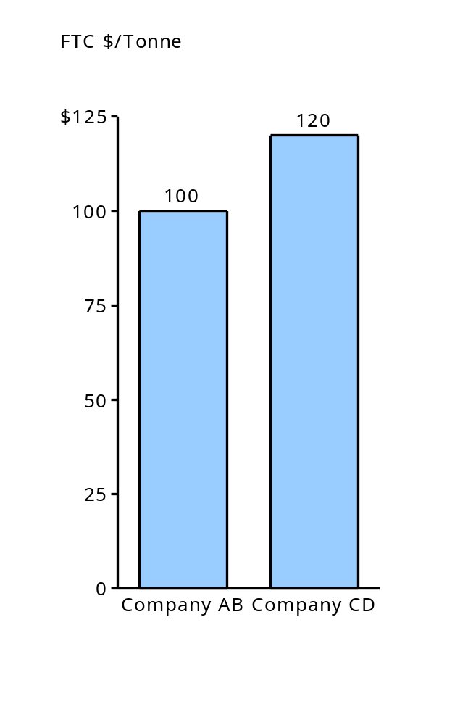
Freight to customer: Approach
ILLUSTRATIVE
1
2
3
Assess difference in freight costs for a large common customer with national distribution
Translate to FTC costs for sample customer
Extrapolate findings to overall FTC costs for all customers
Warehouse
A
Warehouse
B
X%
100 miles
150 miles
ILLUSTRATIVE
Warehouse A
=100 mi x $2/mi
=$200/20 tonnes/truck
Truck = $10/tonne
Warehouse B
=150 mi x $1/mi
=$100/20 tonnes/truck
Truck = $7.50/tonne
Average
=10(100/150) + 7.5(50/150)
= $9.2/tonne
$2.00/mile
$1.00/mile
100 tonnes
50 tonnes
Distribution Center
100 miles
200 miles
$2.00/mile
$1.00/mile
150 tonnes
50 tonnes
Warehouse
C
Warehouse
D
  research deck

Slide 8
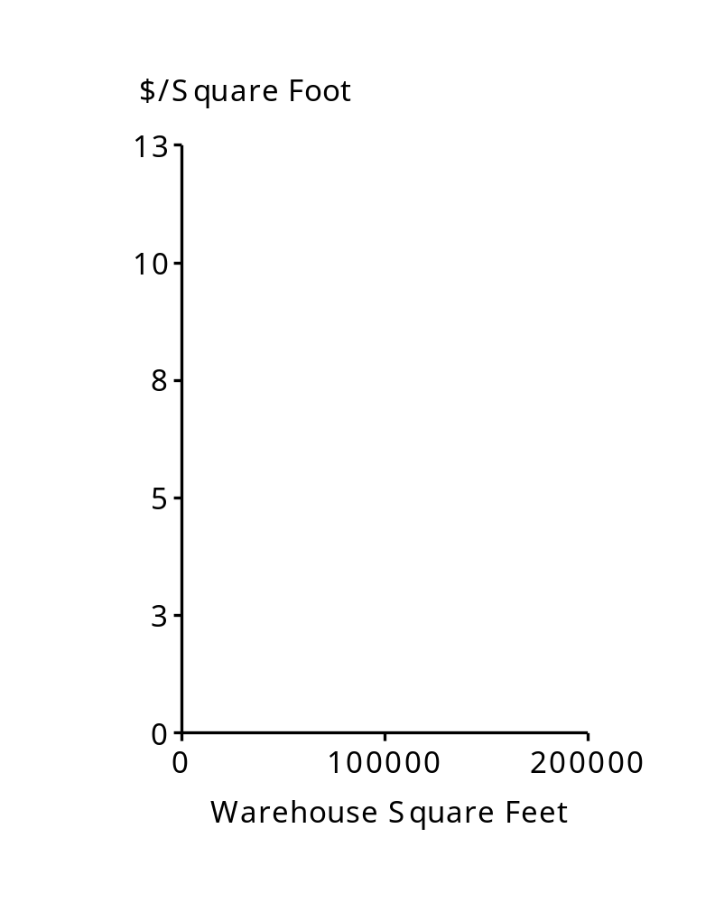
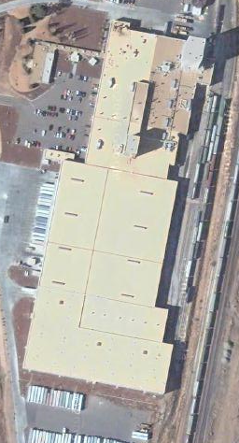
Shipping & Handling: Approach
ILLUSTRATIVE
1
2
3
Determine warehousing square footage
Predict cost using internal cost curve
Translate to approximate cost/tonne
$/sq. ft
X
Sq. ft/tonne*
=
$/tonne
Warehouse C square feet:
400,000
*assume same sq. ft/tonne
  research deck

Slide 9
Outcome
Resolution
Resolution
The team came up with creative ways to allocate all of the major costs involved in the process
Confirmed hypothesis was indeed correct and pointed out a number of areas they were at a cost disadvantage
Response
Response
Company A was very interested in the results, believed in the analysis, and wanted to learn more
Next Steps
Next Steps
The real output of this exercise was where Company B was doing things in innovative ways
Company A moved to adopt learnings through process changes in push to neutralize cost disadvantage

Slide 10
Contacts
Gib Lopez – gilopez@deloitte.com
Craig DePriester – craig.depriester@bain.com

